Slide 1
DESIGN AND SIMULATION OF 6KW WIND POWER GENERATION SYSTEM
Ahelee Guha (RA1711005030015)
Aviral Krishna (RA1711005010195)
Guide: Mrs. Dhanusiya Govindasamy (Asst. Professor EEE)

Slide 2
CONTENTS
Introduction
Forces acting on a wind turbine
Design
Input
Output
Final Model
List of refernces

Slide 3
INTRODUCTION
1
Knowing wind energy and turbine structure

Slide 4
Introduction to wind power generation
Wind Energy: Wind power that is obtained from the wind.
Wind Turbine: A special type of arrangement that converts the kinetic energy of wind to electrical output.
VAWT: Vertical axis wind turbine
HAWT: Horizontal axis wind turbine

Slide 5
Structure of wind turbine
Tower: Constructed to hold the rotor blades off the ground and a an ideal wind speed.
Foundation: Anchors the wind turbine to the ground
Nacelle: Contains gears and a generator
Rotor: Converts the energy in the wind into rotary mechanical movement
Rotor Blades: Blades that rotate due to flowing wind
Hub: Centre of the rotor to which rotor blades are connected

Slide 6
Structure of wind turbine
Gearbox: Used for conversion of low rpm of shaft rotated by the blades to a higher rpm towards the generator input
Generator: Converts mechanical energy to electrical energy
Control System: Controls the function and the operation o the key components of the wind turbine
Heating and cooling system: Ventilators are used to cool off the extra heat from the gearbox and heating system is used to heat the oil in gearbox in winter

Slide 7
FORCES ACTING ON A WIND TURBINE
2

Slide 8
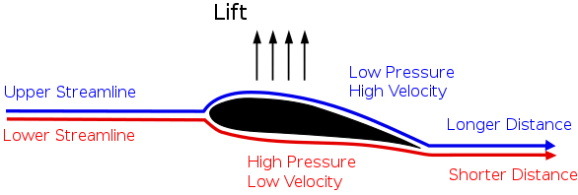
Lift
When a fluid like air when flowing around or over an object exerts a force on it, that component of the force that is perpendicular to the oncoming flow direction is called the lift.

Slide 9
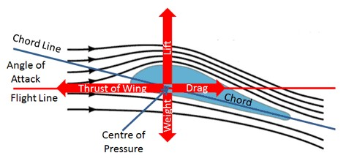
Drag
The force that opposes to the motion of the rotating object under the influence of the acting fluid such as air is called drag, it is also the horizontal component of that exerting force.

Slide 10
Lift vs. Drag
It is the amount of lift generated by an airfoil compared to its drag.
For this NACA 2414 it is coming as 1.501.

Slide 11
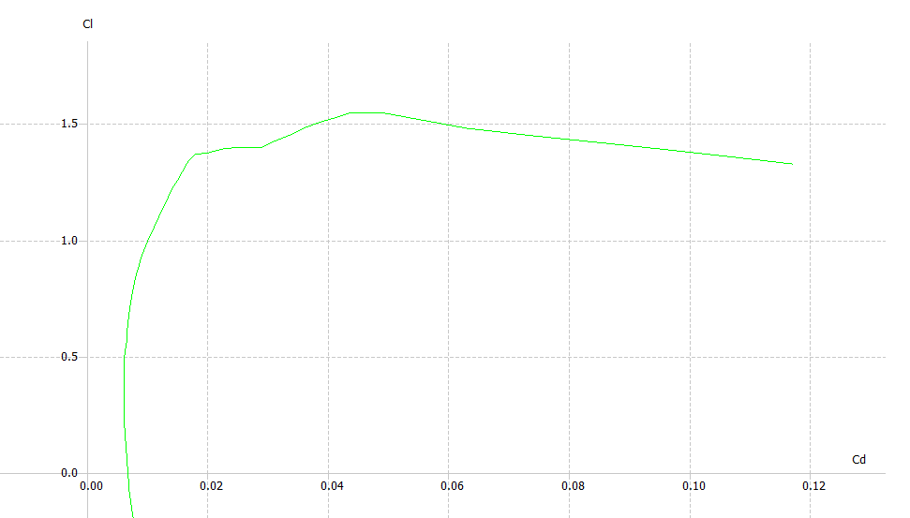
Graphical Representation
Cl vs. Cd

Slide 12
DESIGN
3
Components used for the higher efficient turbines

Slide 13
Airfoil
An airfoil is the foundation of wind turbine blade design. It plays a major role in the input efficiency of the wind turbine.
The software that is used to design blades or the airfoil of the blade is Q-blade. This software provides various simulation and designing tools that hold predefined values and data about the various types of airfoil structure.
The airfoil design used here is called NACA 2414

Slide 14
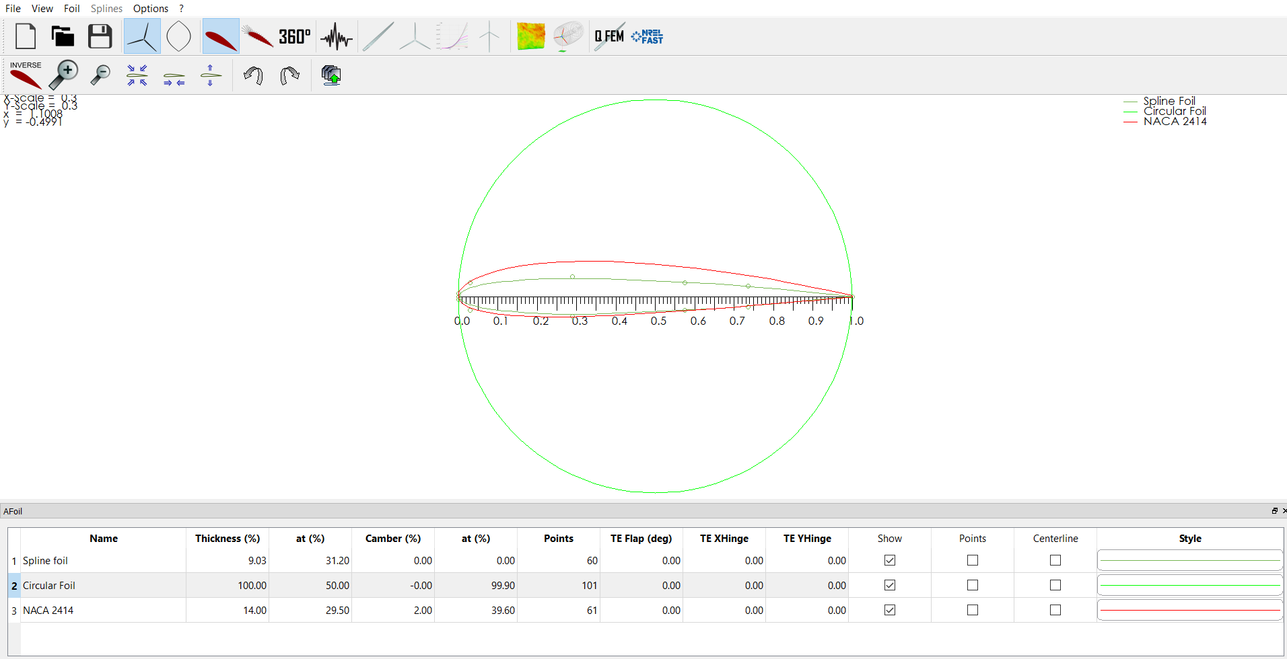

Slide 15
Electrical Components
The components mainly have a wind turbine, two mass drive train, substations to get pitch angle, permanent magnet synchronous machine, three phase V-I measurement, three-phase series RLC branch, voltage measurement, current measurement, RMS for voltage and current, first order filter, two products, one divide, three gains of 1.732, -1, 1/152.8, three constants of 12 for wind speed, 8500, 152.8, eight scopes and two displays connected intricately as a network.

Slide 16
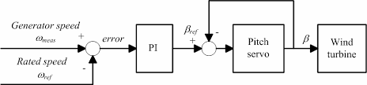
Pitch Angle Controller
Pitch control is the technology used to operate and control the angle of the blades in a wind turbine. It is made up by electric motors and gears, or hydraulic cylinders and a power supply system.
.

Slide 17
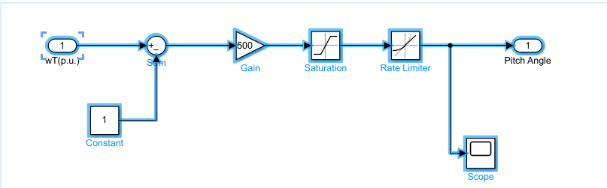
PAC design created in Simulink

Slide 18
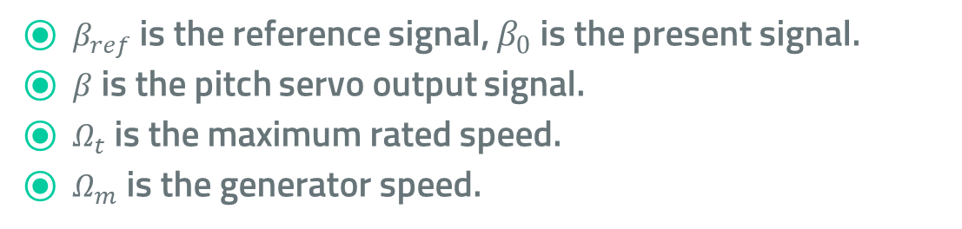

PAC Equations
$β_{ref}=β_{0}=0 for 0<Ω_{t}<Ω_{m}$
$β_{ref}=\frac{∆β}{∆Ω}\left(Ω_{t}−Ω_{m}\right)+β_{0} for Ω_{t}>Ω_{m}$
$β=\frac{1}{1+t_{b}s}β_{ref}$
$β_{ref}$ is the reference signal, $β_{0}$ is the present signal.
$β$ is the pitch servo output signal.
$Ω_{t}$ is the maximum rated speed.
$Ω_{m}$ is the generator speed.

Slide 19
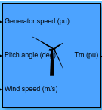
Wind turbine function block
The MATLAB/Simulink 2021 offers a predefined function block that acts a wind turbine considering every parameter like wind speed(m/s), torque(pu), pitch angle(deg) and generator speed(pu).

Slide 20
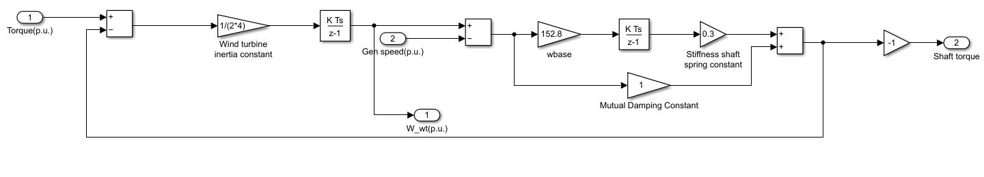
Two-mass drive train
A drive train is there to help transfer the torque from the turbine blades to the generator.

Slide 21
Two-Mass Drive Train Equations
2H_{t} dw_{t}/dt = T_{m} – T_{s}
(1/w_{ebs})(dθ_{sta}/dt) = w_{t} – w_{r}
T_{s =} K_{ss}θ_{sta} +D_{t}(dθ_{sta}/dt)
Ht= Inertia constant, θsta= Shaft twist angle, Wt= Angular speed of turbine
Wr= Rotor Speed of generator, Webs= Electrical base speed
Ts= Shaft Torque
Kss= Shaft Stiffness
Dt= Damping Coefficient

Slide 22

Permanent magnet synchronous generator
The Permanent Magnet Synchronous Generator (PMSG) is used to produce electricity from the mechanical energy obtained from the wind.

Slide 23
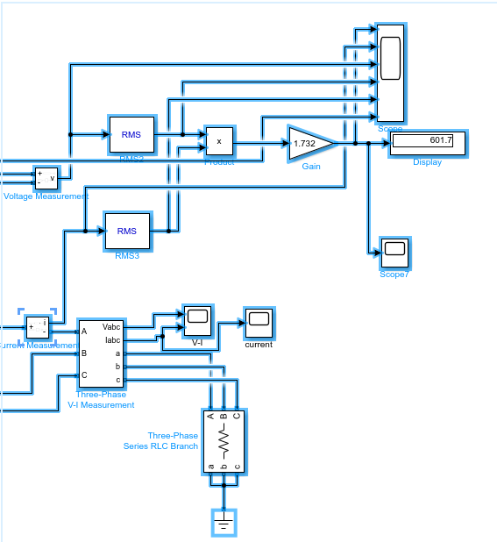
Other electrical components
Voltage and current measurement block
Three phase RLC branch
Power output

Slide 24
INPUT
4
Values and graphs that has been used as input

Slide 25
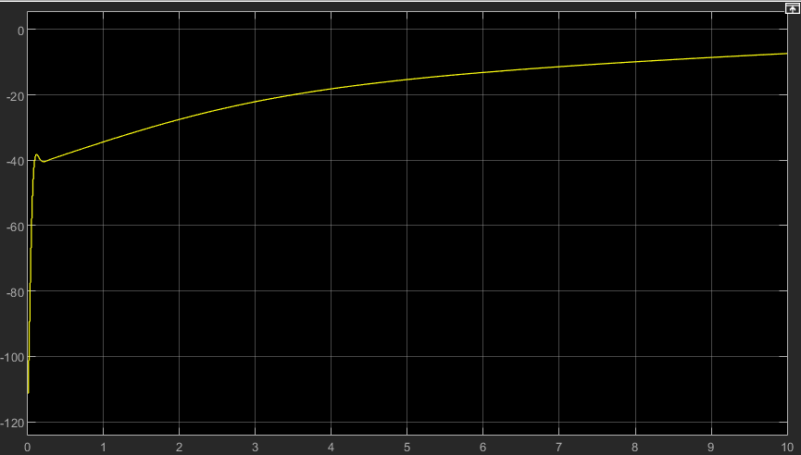
Input Parameters
Wind speed = 12 m/s
Torque = -0.7 to -0.1 pu
Pitch angle = 0.2 degrees
Generation speed for drivetrain = 1.2 pu
Torque input to generator=

Slide 26
RESULT
5
Output graphs that show the result

Slide 27
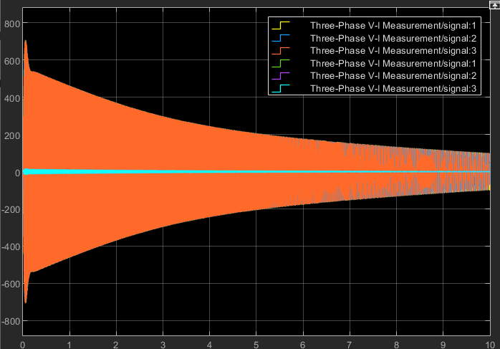
Voltage and current and Power

Slide 28
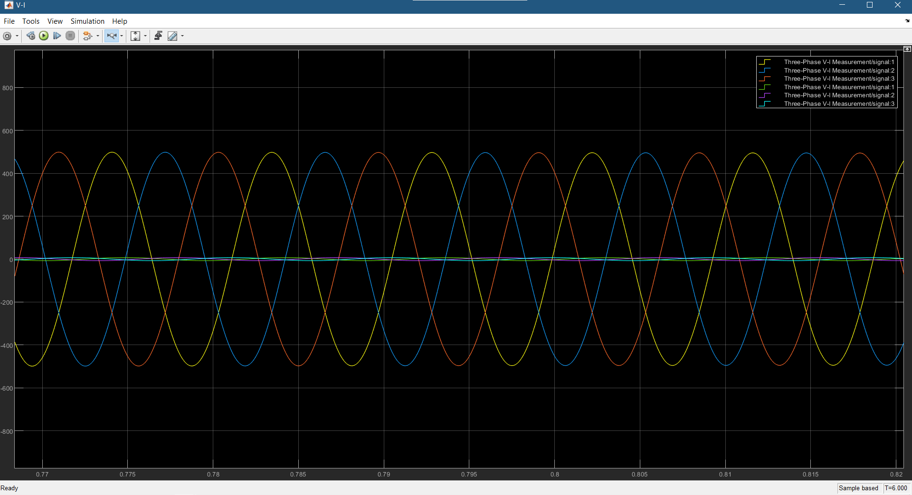
Voltage(V)

Slide 29
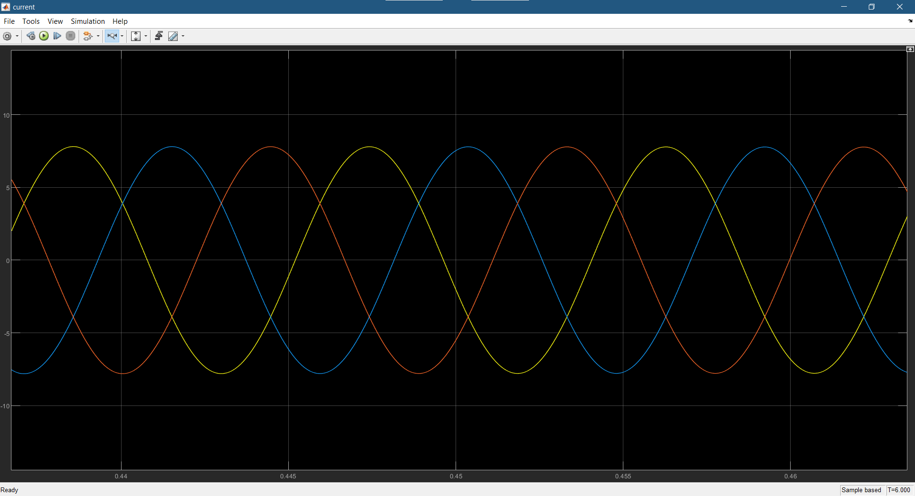
Current(I)

Slide 30
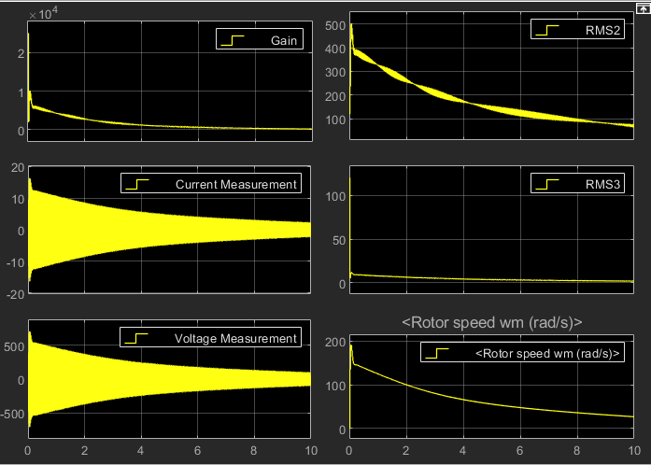
Individual Graphs

Slide 31
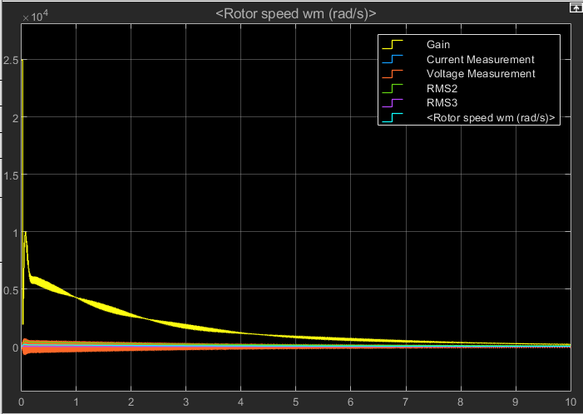
Generalised Graph

Slide 32
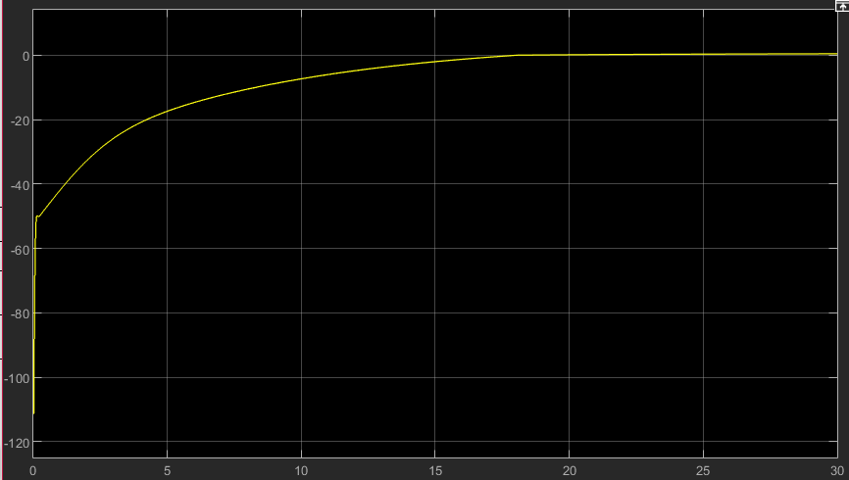
Proposed design output

Slide 33
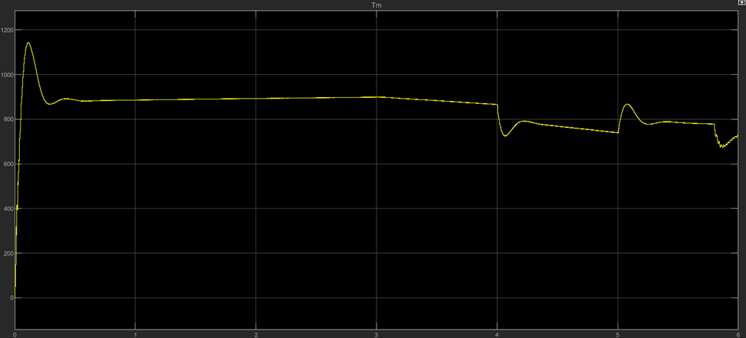
Generalized output from other resources

Slide 34
FINAL MODEL
6
Final model designed with the MATLAB/Simulink

Slide 35
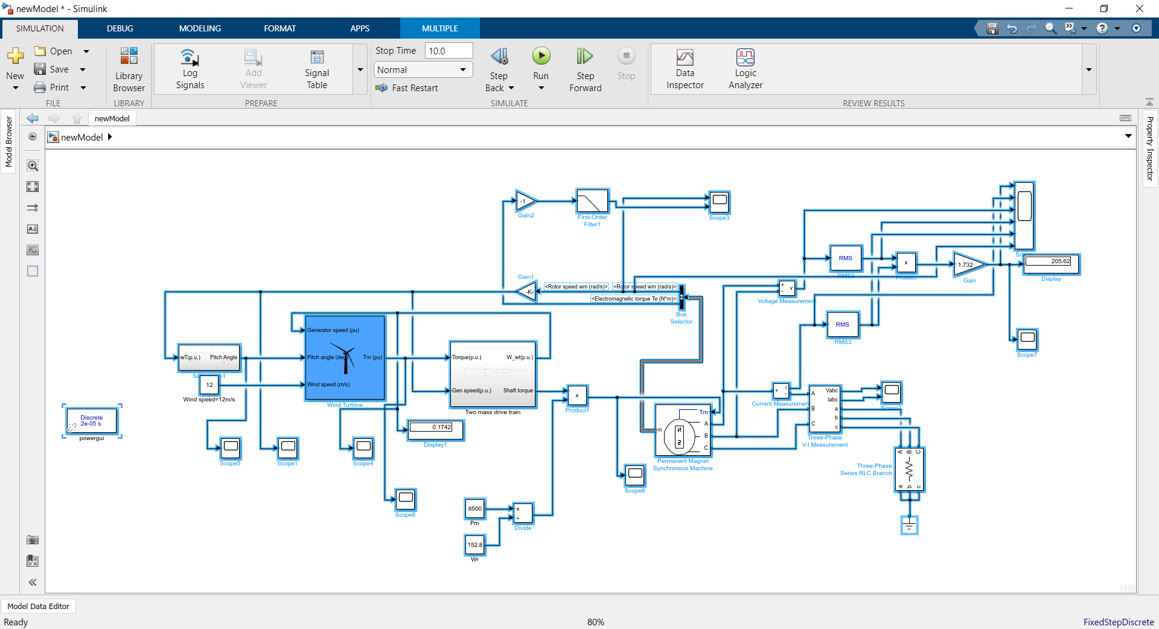

Slide 36
List of References
The WEI6K, a 6-kW 7-m Small Wind Turbine
Dynamic Modelling, Control and Simulation of a Wind and PV Hybrid System for Grid Connected Application Using MATLAB
Modelling and simulation of wind-generator with fixed speed wind turbine under Matlab-Simulink
Simulation and Control of Solar Wind Hybrid Renewable Power System
A review on the inclusion of wind generation in power system studies

Slide 37
THANKS!
Any questions?
Ask us:
Ahelee Guha (RA1711005030015)
Aviral Krishna (RA1711005010195)

